Slide 1
Machine Learning:
Predicting King County Housing Prices
Team Rho
Paul Jaquish, Angela Stallman,
Megan Ling, Giorgi Lomaia

Slide 2
Agenda
Business Problem Overview
Data Obtaining and Cleansing
Modeling Approaches
Multi-Linear Regression, GLM and KNN
Analysis & Conclusion

Slide 3
Business Problem Overview
Our Goal: To purchase a house that is being sold under market value
Predict King County Housing Price
What factors decide the selling price in King county?
Business insights
Everyone needs a place to live - Including, the one and only, Paul Jaquish

Slide 4
Data Obtaining & Data Cleansing
Data Obtaining
Kaggle.com
House Sales in King County, USA
US Household Income Statistics
Notes:
Data Obtaining - Kaggle dataset to predict housing data
We believe income is a determined factor in housing price prediction. So we find U.S. household income statistics data to find the household Income
Matching the two dataset with the Same zip code using Alteryx

Slide 5
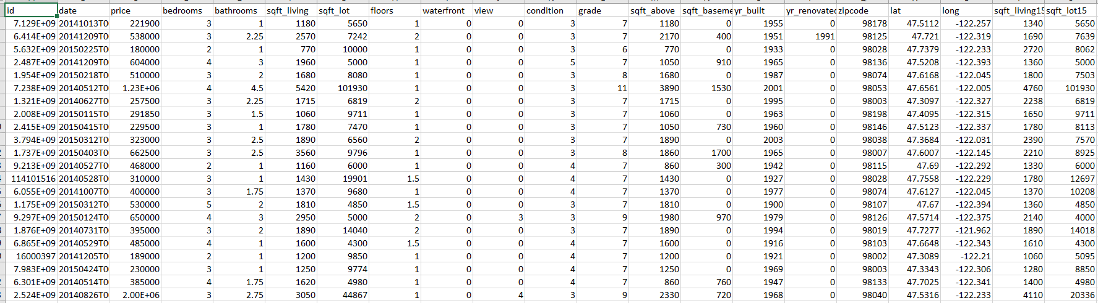
Data Cleansing - Before

Slide 6
Data Obtaining & Data Cleansing
Data Cleansing
Excel
Check the zipcode of household income data includes the zipcode from King County
Alteryx
Combine two CSV dataset with matching Zip Code
Get rid of IDs & Date
Determined categorical variables
E.g. Condition & Grade
Notes:
Data Obtaining - Kaggle dataset to predict housing data
We believe income is a determined factor in housing price prediction. So we find U.S. household income statistics data to find the household Income
Matching the two dataset with the Same zip code using Alteryx
Federal grading system - how well the house structure holds/effort was put into it
Second- determined categorical variables
-Condition
-Grade
These had no numeric value - represent a rating system

Slide 7
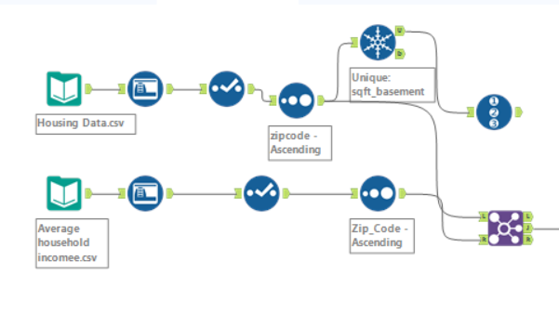
Alteryx
Notes:
Matched zip codes from the two excels in order to pull through average income

Slide 8
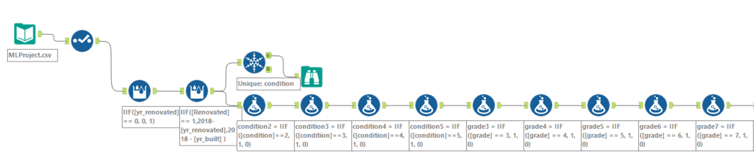
Alteryx - Classification

Slide 9
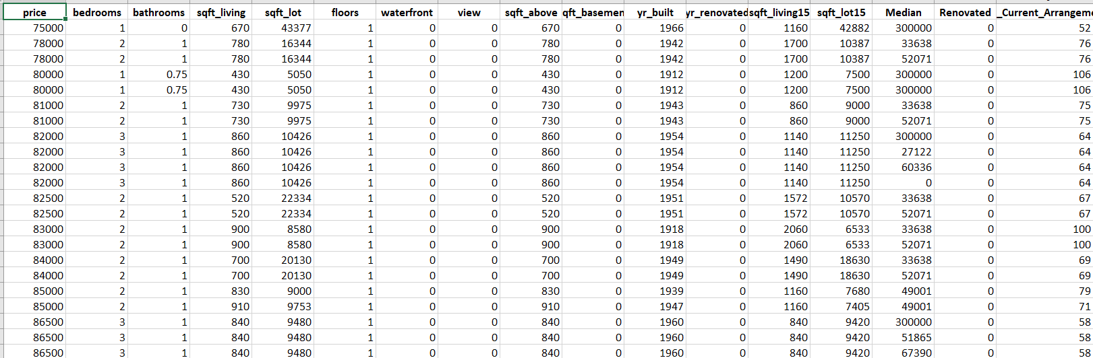
Data Cleansing - After

Slide 10
Model Selection
Multiple-Linear Regressions - BIC & Cp
Logistic Regression- Significance of variables
KNN - hand picked

Slide 11
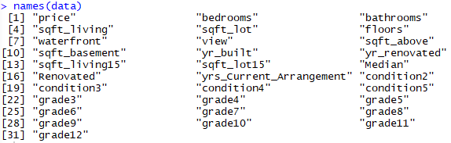
Variables
Dependent variable : price
Independent variables including (30):

Slide 12
Predictive Settings
Set.seed (5072)
Test set → Random 0.001 sample
Train Set → 0.999

Slide 13
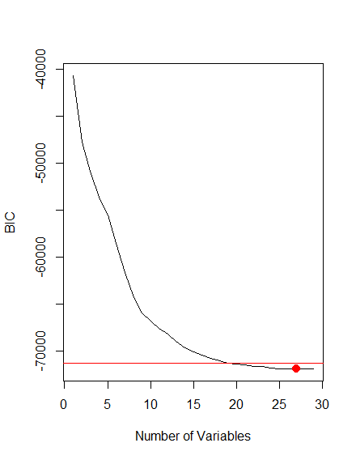
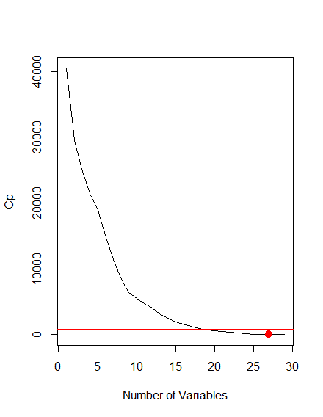
Find Best Set of Predictors for MLR

Slide 14
Variables Chosen
Added in all grade variables for completeness

Slide 15
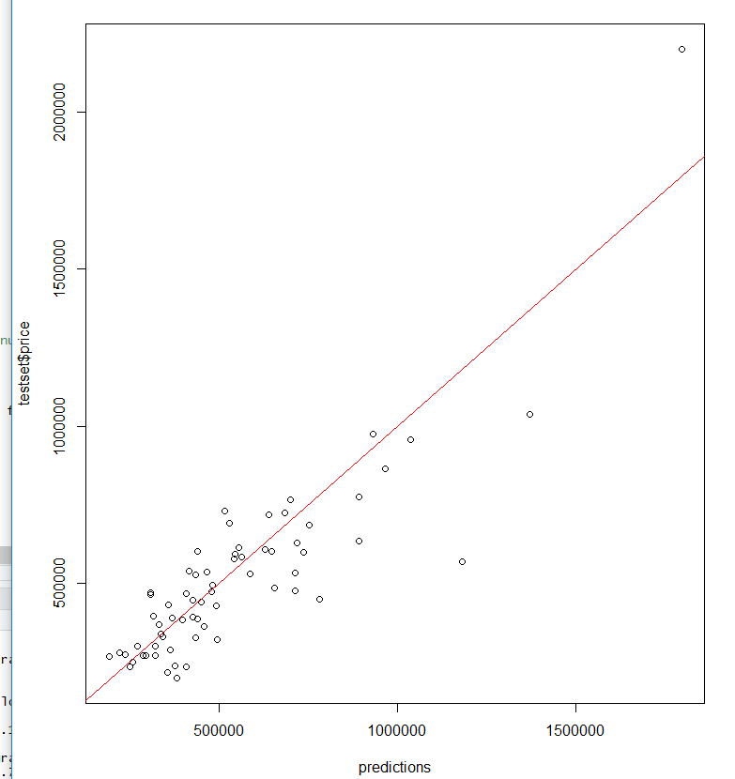
Results of First Model

Slide 16
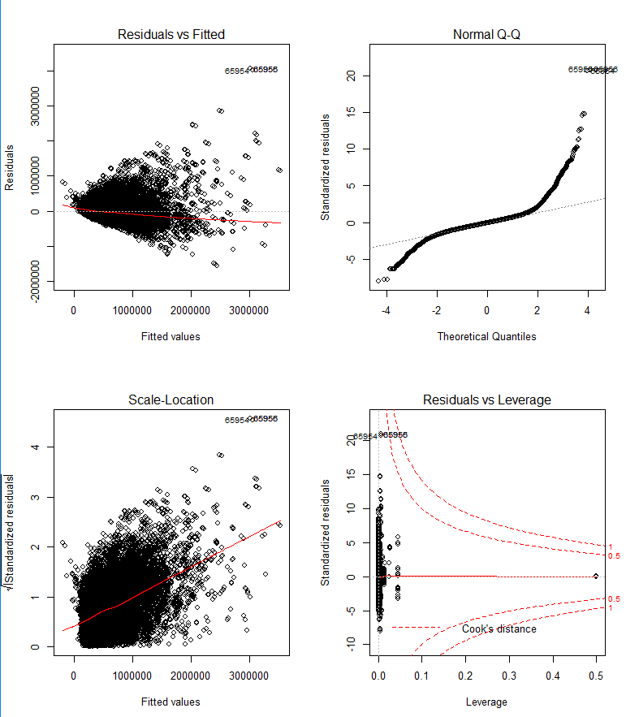
Results of First Model (cont.)

Slide 17
Key Findings from First Model
Q-Q plot suggests very fat tails (not normal)
Heteroscedasticity of variance of residuals
Trended residuals
Solution: monotonic transformations! (log and sqrt)

Slide 18
Log Model
Plots looked much better (we’ll get to those later)
However, a look at the summary showed that not all variables were significant

Slide 19
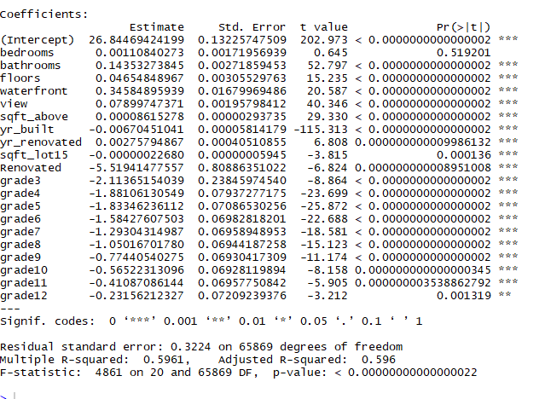
Log Model Summary

Slide 20
Problem of Colinearity
Regression Subsets function was warning that some predictors were colinear
Tested this using the VIF function

Slide 21
VIF Function Results
bathrooms floors waterfront view sqft_above yr_built yr_renovated sqft_lot15 Renovated
2.333236 1.682529 1.219901 1.338736 3.129711 1.791834 16453.242875 1.066444 16455.280367
grade3 grade4 grade5 grade6 grade7 grade8
1.094111 4.418573 31.672314 257.810767 750.672857 623.736938
grade9 grade10 grade11 grade12
307.070697 135.199796 49.407743 11.261116

Slide 22
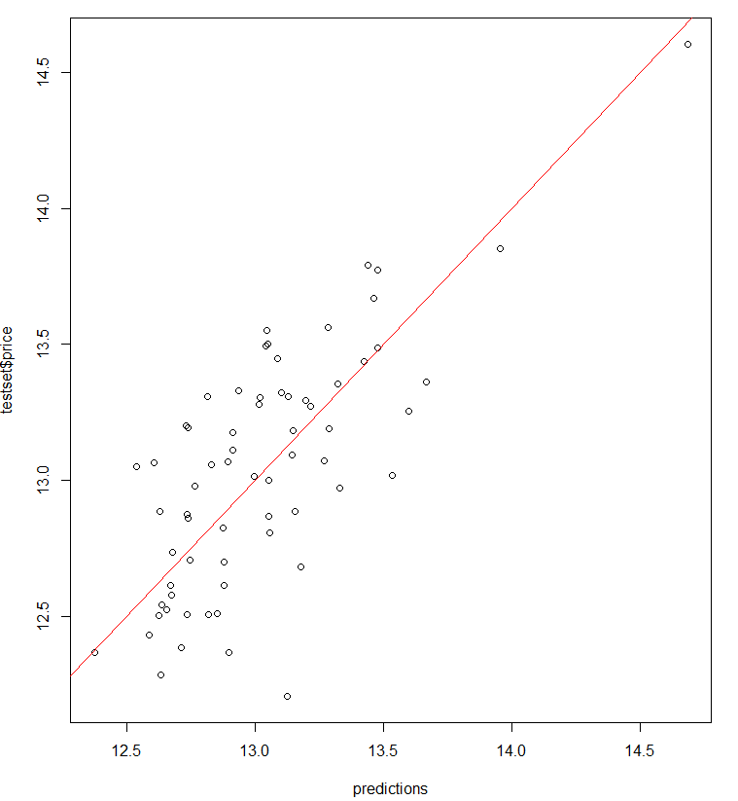
Final Model

Slide 23
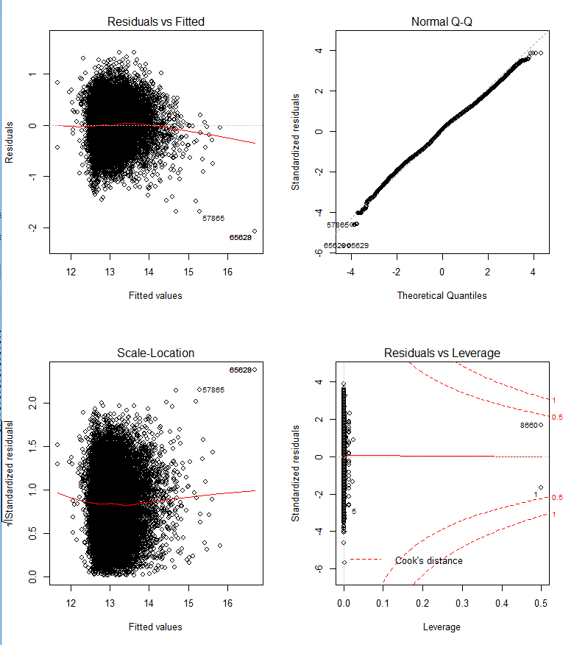
Final Model

Slide 24
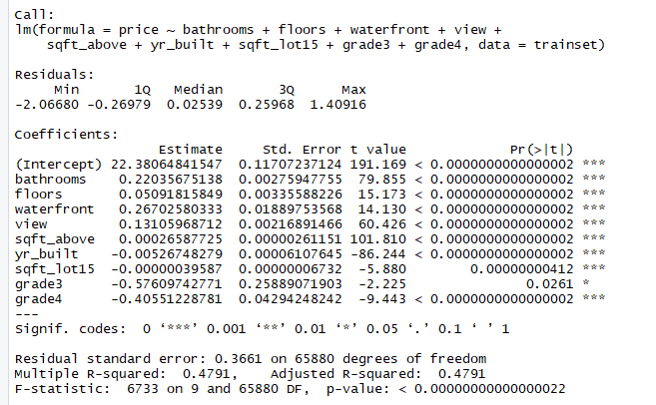
Final Model

Slide 25
Potential Problems
Non-Linearity of Data
Endogeneity
Collinearity among Predictors
Heteroscedasticity
Serial Correlation of Error Terms
All avoided if log(price) < 15

Slide 26
Prediction Intervals
Need Linearity, Independent Errors, Normal Errors, Equal Error Variances (LINE)
Potential Problems proved all but normal errors, which can be seen from QQ Plot

Slide 27
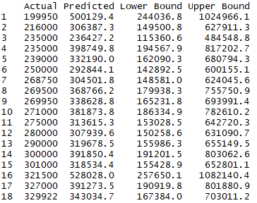
Prediction Intervals

Slide 28
Evaluation
Using all elements in the test set, we get an MSE of 21,105,933,974 (RMSE of $145,278.8)
R squared was .4791

Slide 29
Classification
High - Above Median
Low - Below Median

Slide 30
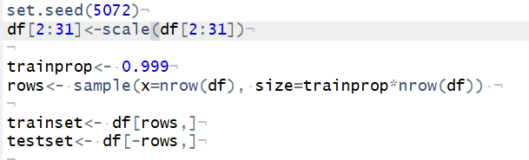
GLM
Variables dropped: Grades & Waterfront

Slide 31
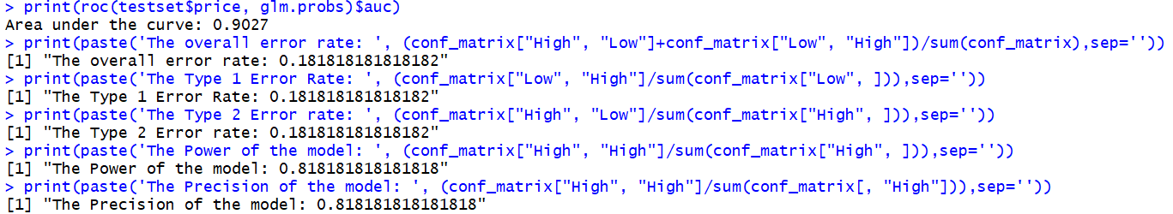

GLM - Metrics

Slide 32
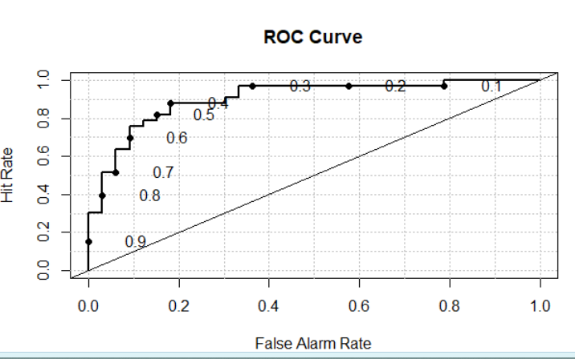
GLM - ROC Curve

Slide 33
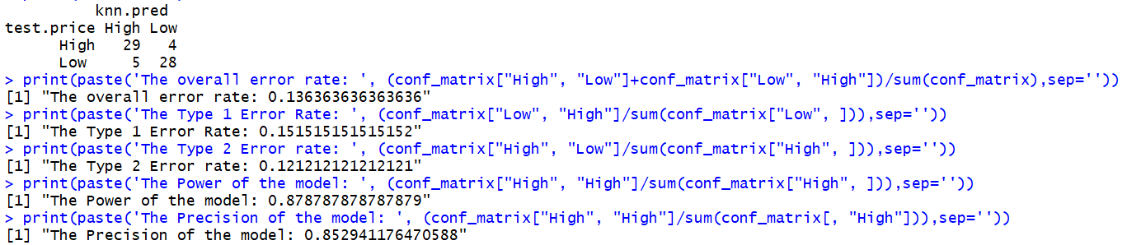
KNN
Variables Selected: Sqft_living, floor, yr_build
Best K = 3, chosen from odd numbers 1:90

Slide 34
Modeling Approach Summary
The Overall error rate KNN
The Type 1 error rate KNN
The Type 2 error rate KNN
The Power of the model KNN
The precision of the model KNN

Slide 35
KNN is the best
Highest percentage of modeling fit
Limitation of the KNN
Only 2-3 variables
Hard to determine which variables is going to be useful

Slide 36
Conclusion
Difficulties
Trouble selecting dataset
LDA - doesn’t work! (too many rows)
Lots of Variables
Hard to decide which one we should drop

Slide 37
Thank you

